Slide 1

SmartShelfX -
Smart Inventory Forecast and Auto Restock
Transforming Inventory Operations Through Intelligent Automation
Team Members :
Abhijeet Kale Jenia Chakraborty Tamilselvi M
Vishal M Mentor Name : Suramya Biswas
Notes:
1

Slide 2
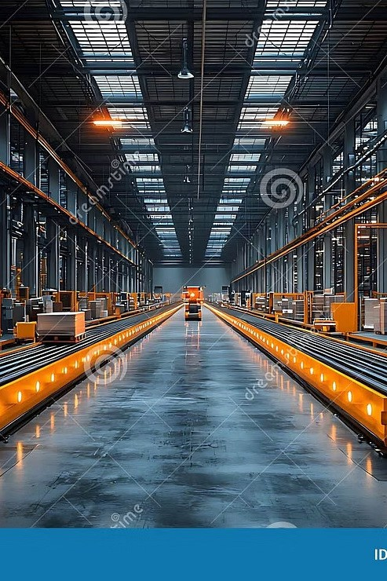
A Modern Approach to Inventory Management Systems
Inventory management is a critical backbone for retail and warehouse operations. Traditional, manual systems are prone to human error, leading to inefficiencies and significant costs.
SmartShelfX enhances the inventory management process through structured data analysis, enabling better demand estimation and organized inventory restocking.
Notes:
1

Slide 3
Core System Objectives
01
02
Automate Operations
Secure Access Control
Replace manual inventory tracking with intelligent automation that saves time and reduces errors.
Implement role-based permissions ensuring the right people access the right information.
03
04
Real-Time Monitoring
Generate Insights
Enable instant visibility into stock levels, movements, and critical thresholds across all locations.
Produce comprehensive reports and analytics that drive informed business decisions.
05
06
Optimize Management
Enhance Security
Streamline order processing and vendor relationships for improved efficiency and collaboration.
Protect sensitive data while delivering an intuitive, user-friendly experience across the platform.
Notes:
4

Slide 4
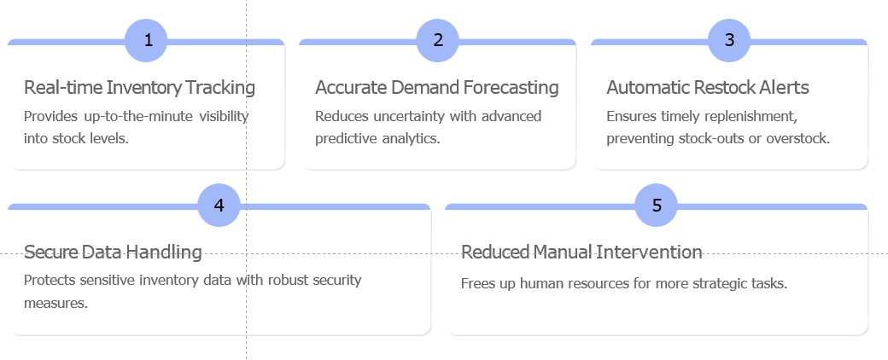
Key Features & Benefits of SmartShelfX

Slide 5

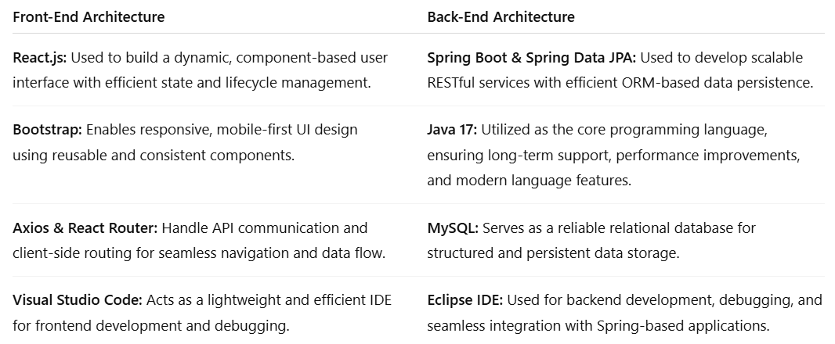
Powerful Technology Stack
Notes:
1

Slide 6
Comprehensive System Modules
User Management
Product Management
Inventory Management
Secure authentication, authorization, and role-based access control for different user levels and departments.
Complete CRUD operations for products, category organization, and detailed item specifications management.
Real-time stock tracking, Stock Keeping Unit (SKU) management, automated reorder points, and multi-location inventory control.
Transaction Management
Vendor Management
Comprehensive sales and purchase recording, transaction history, audit trails, and financial reconciliation.
Centralized vendor database, performance tracking, purchase order generation, and supplier relationship tools.
Notes:
6

Slide 7






System Workflow
Authentication
Users log in securely with role-based credentials, establishing their access level and permissions.
Dashboard Overview
Interactive dashboard displays critical metrics, alerts, and real-time inventory status at a glance.
Inventory Operations
Manage products, update stock levels, track movements, and monitor SKU availability across locations.
Order Processing
Create purchase orders, manage vendor relationships, and track shipments through the entire lifecycle.
Transaction Recording
Automatically capture sales and purchases, maintaining comprehensive transaction history and audit trails.
Analytics & Reports
Generate detailed reports, analyze trends, and extract actionable insights for strategic decision making.
Notes:
7

Slide 8
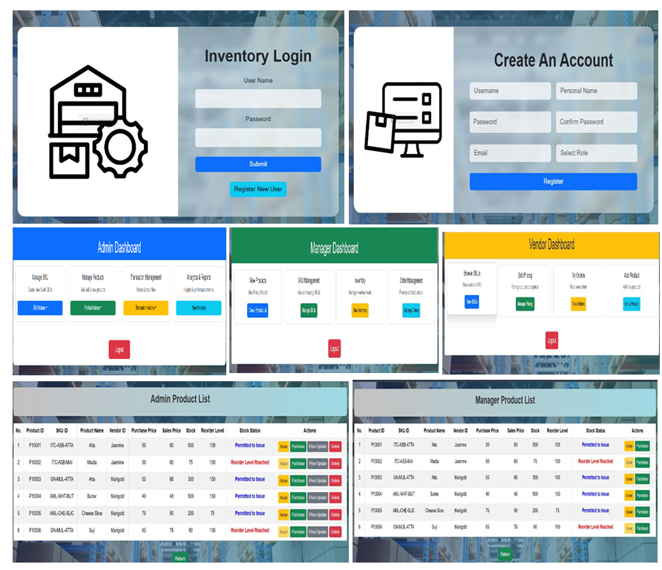
Prototype Overview (1)

Slide 9
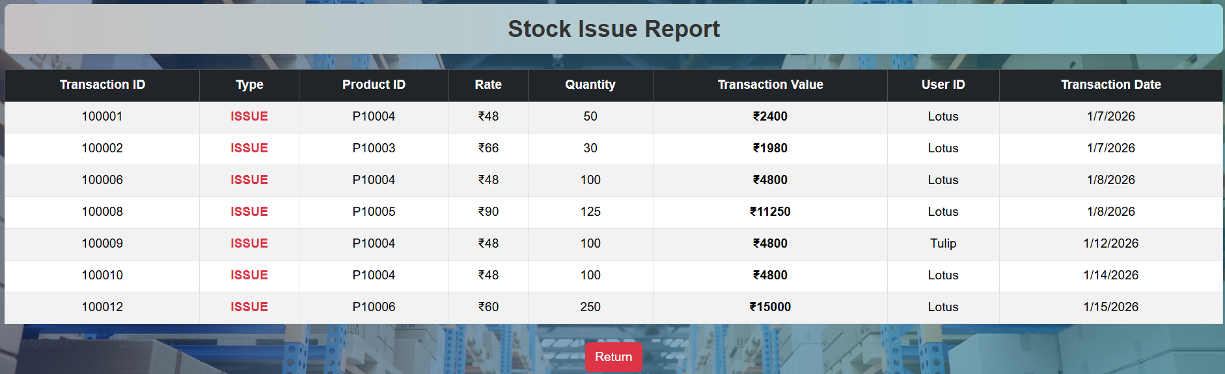
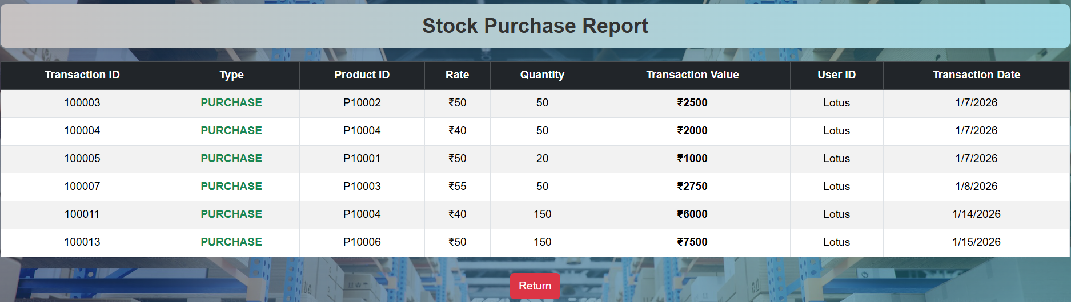
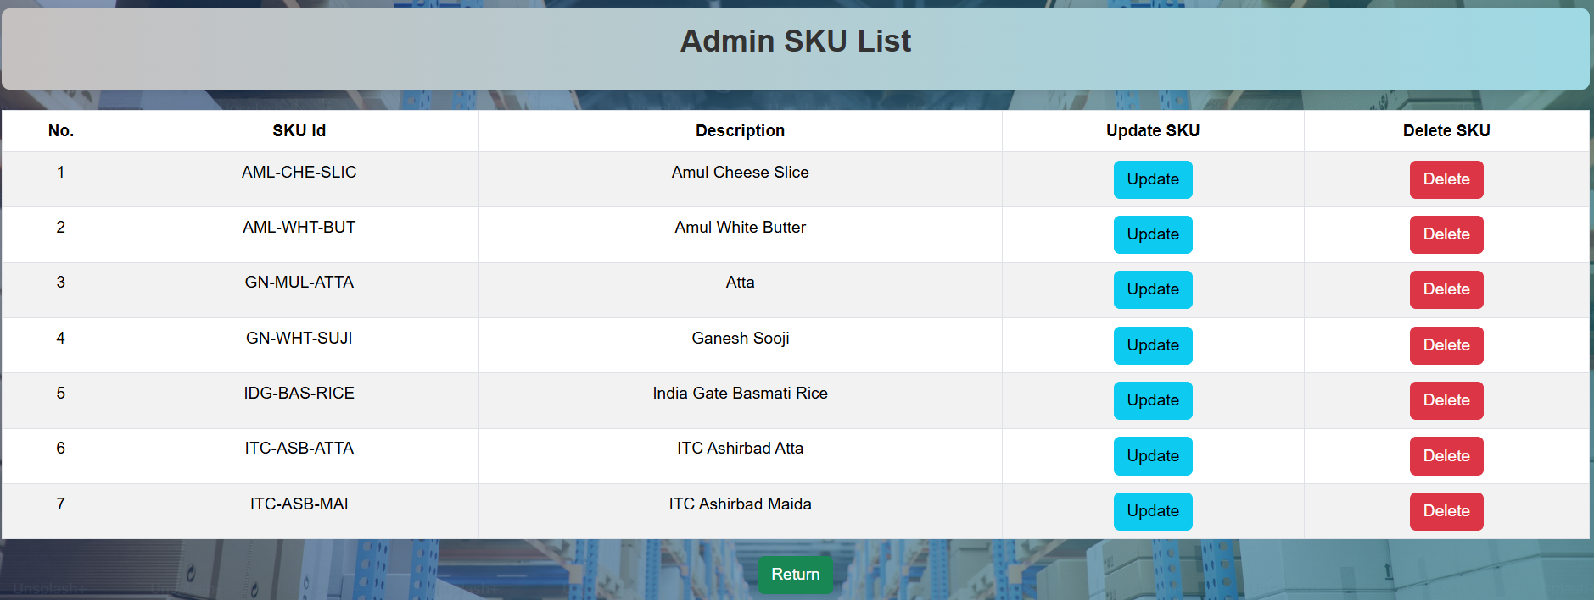
Prototype Overview (2)

Slide 10
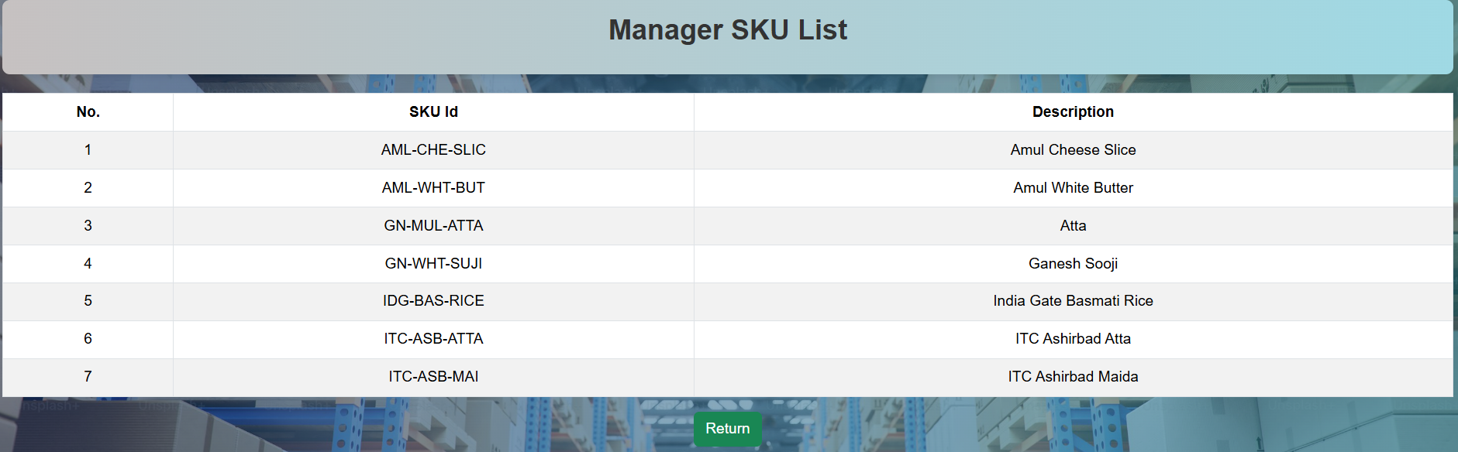
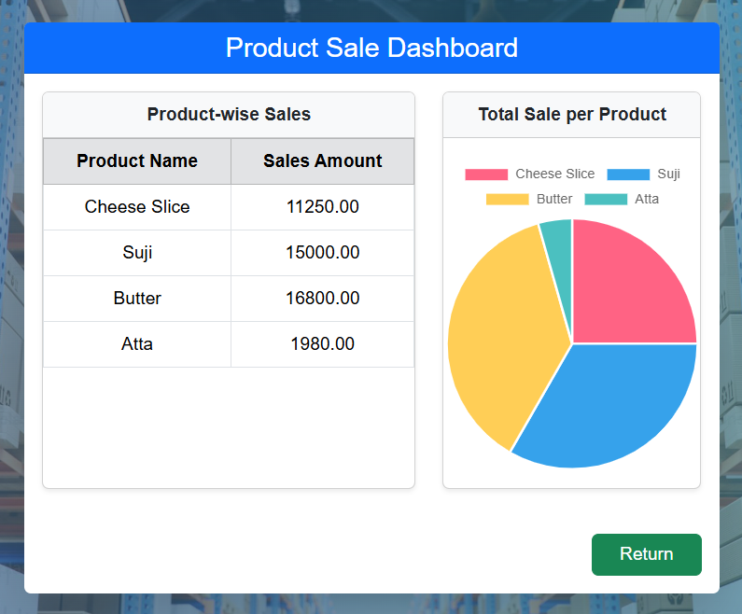
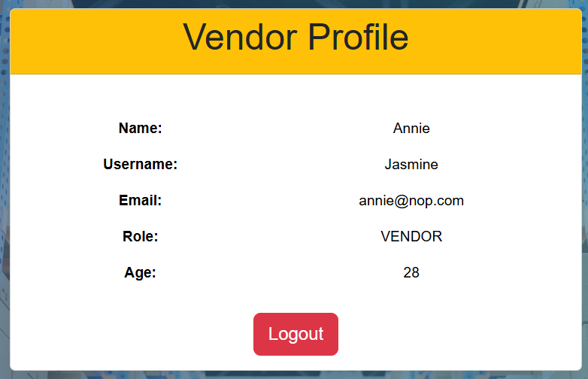
Prototype Overview (3)

Slide 11


Measurable Business Impact
80%
100%
95%
Efficiency Gain
Real-Time Visibility
Order Accuracy
Reduction in manual work through intelligent automation and streamlined processes.
Complete inventory transparency across all locations and channels at any moment.
Improved precision in order fulfillment, reducing errors and customer complaints.
Additional Benefits
Data-driven decision making with advanced analytics
Strengthened vendor partnerships through better collaboration
Enterprise-grade security protecting sensitive business data
Scalable architecture growing with the organization
Notes:
8

Slide 12

The Challenge We're Solving
Manual Inefficiency
Time-consuming manual tracking processes drain resources and increase operational costs across the organization.
Limited Visibility
Lack of real-time stock insights creates blind spots, leading to stockouts and overstocking issues.
Management Complexity
Fragmented vendor relationships and order processes result in delays and communication breakdowns.
Reporting Gaps
Difficulty generating actionable insights prevents data-driven decision making and strategic planning.
Notes:
2

Slide 13
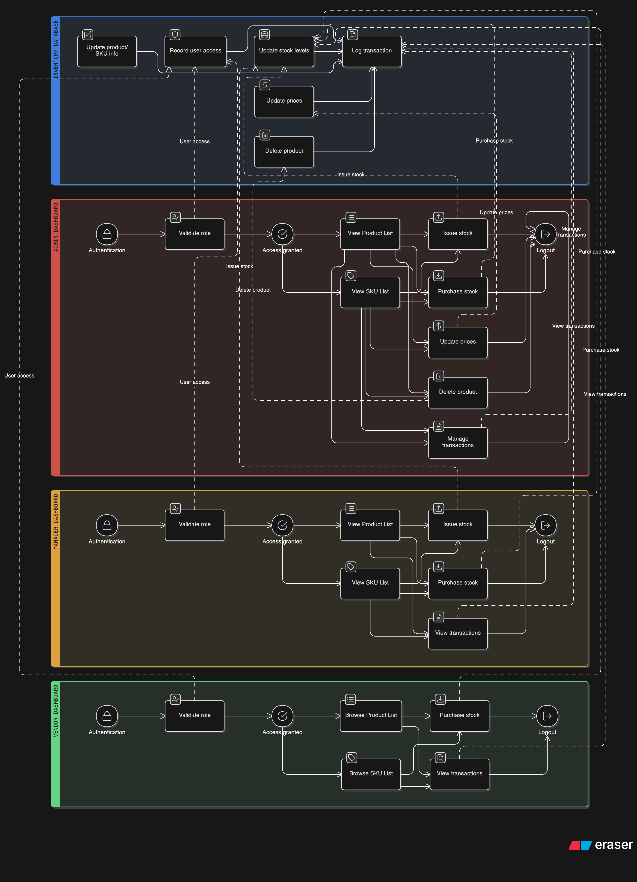
Our Automated Solution
Intelligent Automation
Our comprehensive inventory management system eliminates manual processes, providing real-time visibility across your entire supply chain.
Automated stock tracking with intelligent alerts
Streamlined vendor collaboration tools
Advanced analytics and reporting dashboard
Role-based security and access control
Notes:
3

Slide 14




Conclusion
Streamlined Operations
Improved Accuracy
Transformed inventory management from manual chaos to automated precision.
Enhanced efficiency and eliminated errors across all inventory processes.
Data-Driven Insights
Scalable Solution
Empowered decision making through comprehensive analytics and reporting.
Built for growth with enterprise security and reliability at its core.
Future Vision
SmartShelfX is a smart inventory management system that forecasts demand and automates restocking. It helps businesses reduce cost, improve efficiency, and ensure product availability. We envision future enhancements including IoT-enabled smart shelves, mobile application integration, and advanced AI prediction models.
Notes:
9

